Slide 1





Department of Artificial Intelligence and Machine Learning
Synthetic Data Generator
Malak Soni(22AIML053) Ansh Trivedi(22AIML056)

Slide 2




Introduction
to SDG
Synthetic Data Generator
Why?
Faced difficulties collecting real-world data during the internship, and existing synthetic data platforms were very costly.
To solve this, we decided to develop an affordable synthetic data generator for our semester project.
How!
With prior experience in GANs from our Image Resolution Enhancer project, we chose CTGAN for realistic tabular data generation.

Slide 3



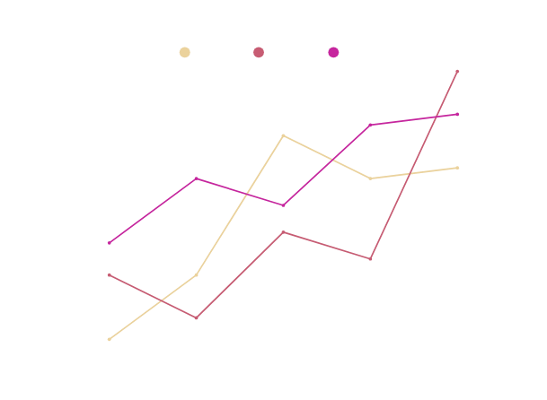
Problem
Overview
Data is everywhere
Machine Learning
Deep Learning
Data Analytics
Data Science
Real World Data Collection is:
Expensive
Time-consuming
Restricted due to privacy regulations.

Slide 4




Generative Advesarial Network
CTGAN
What is CTGAN? CTGAN (Conditional Tabular GAN) is a deep learning model for generating high-quality synthetic tabular data.
Handling Data Distributions: It effectively models complex data distributions and addresses imbalances in datasets.
Realistic Data Generation: CTGAN ensures that synthetic data maintains realistic correlations and relationships between columns.
How It Works: CTGAN uses a generator and discriminator in a competitive process, where the generator creates synthetic data, and the discriminator distinguishes between real and fake data, improving the generator over time.

Slide 5


Frontend
Backend
HTML,CSS,Bootstrap, Jinja2 Templates
Python, Flask
Technology Stack
Data Handling
MODEL
Pandas, Numpy
CTGAN

Slide 6

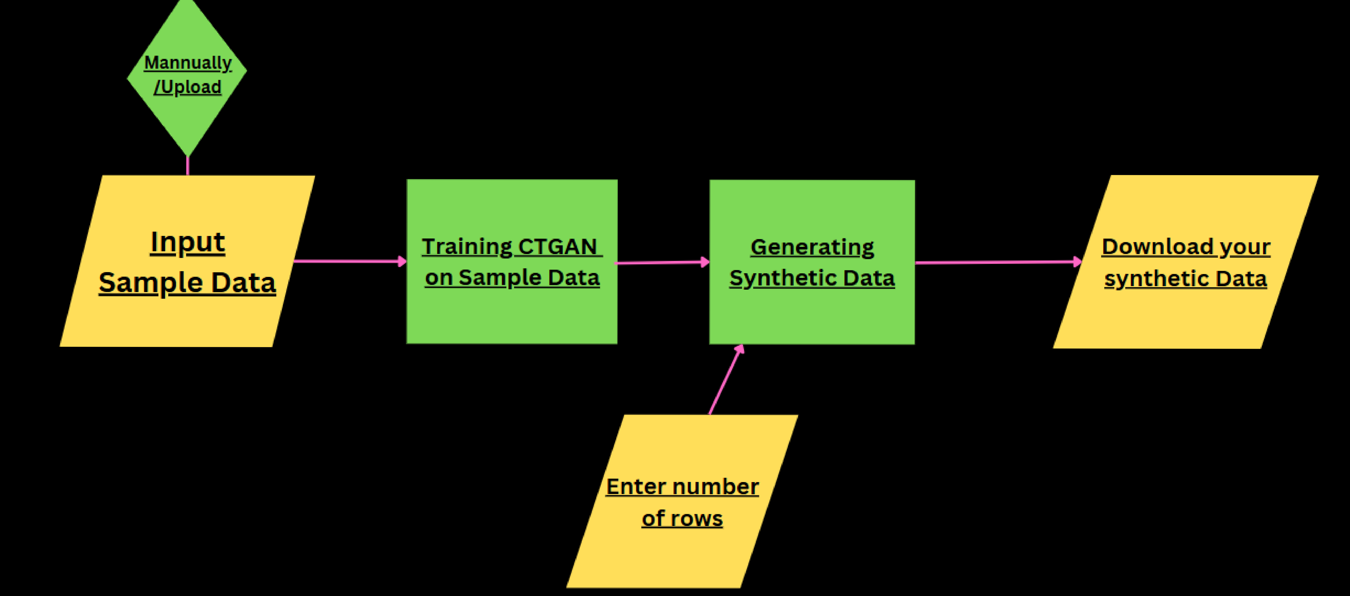

Flow of SGD

Slide 7
Features
How It works
User selects sample size, column details, and data types.
Backend processes and generates data accordingly.
Data is shown in a table view.
User can download the generated dataset as CSV.
Supports multiple data types.
Customizable number of samples and columns.
Easy-to-use interface.
CSV download option.
Realistic data generation using CTGAN.

Slide 8

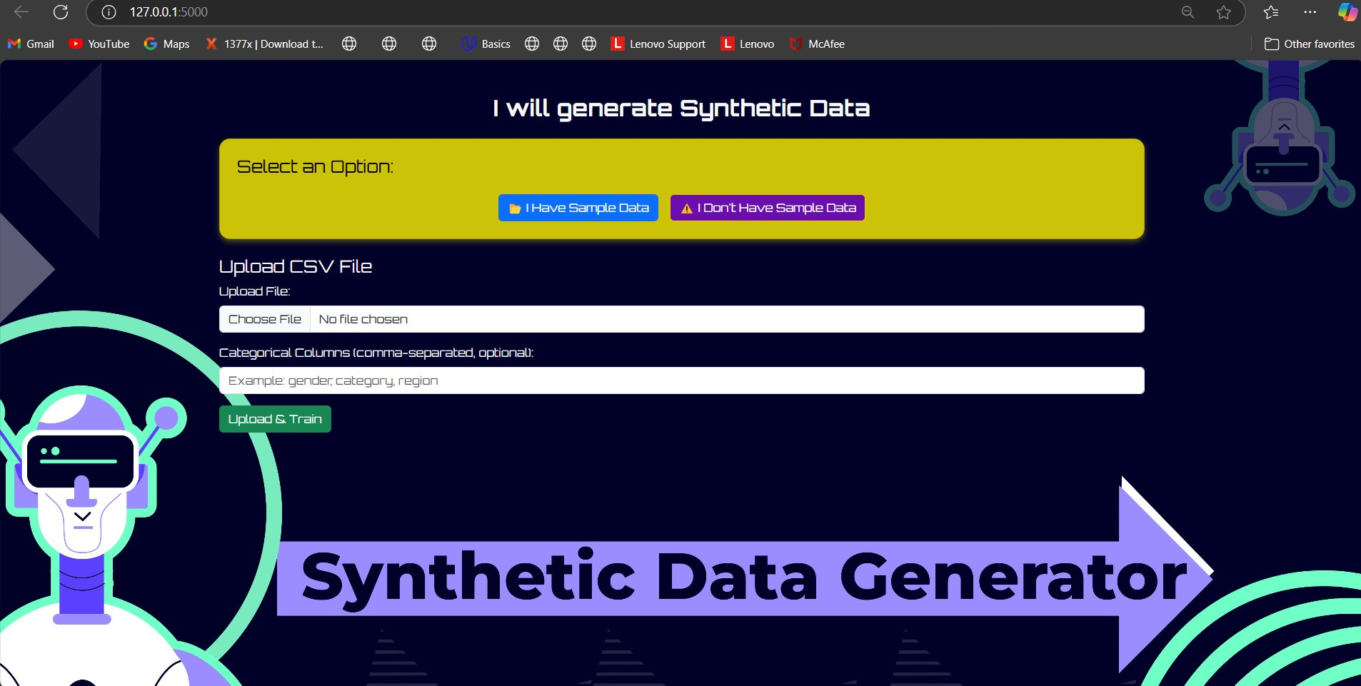

Home Page

Slide 9

Challenges:
Managing multiple data types.
Size of Training sample affect on output.
Learnings:
Exposure to advanced GAN techniques.
Exposure to Web Development

Slide 10

Thank You!
Malak Soni :- 22AIML053 Ansh Trivedi :- 22AIML056

